Slide 1
The late-1960s:
Minimalism
Post-Minimalism
Light and Space
Notes:
Late-1960s
A “cultural revolution” was underway
Led by activists, thinkers, and artists
Sought to rethink and even overturn what was, in their eyes, a stifling social order ruled by conformity
The Vietnam War, the Civil Rights Movement, and feminism
Artists are moving away from Pop art
Need something more tangible and real
A return to MATERIALS
Materiality is key – the most important thing
Embrace materials and techniques of manufacturing and industry

Slide 2
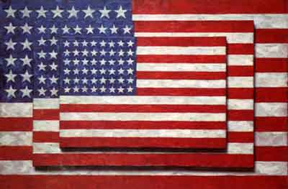
“My painting is based on the fact that only what can be seen there is there... What you see is what you get.”
Jasper Johns, Three Flags, 1958
Encaustic on canvas
Collection Whitney Museum
Frank Stella, The Marriage of Reason and Squalor, 1959
Enamel on canvas, 7' 6 3/4" x 11’ ¾"
Collection MoMA
Notes:
FRANK STELLA (1936- )
Before we delve into minimalism, let’s look at a key transitional figure
Realizes early on he has no interest in representational painting
Looking at Newman’s flat compositions – very linear
1958: Sees Johns’s first show
Flags and targets
Not objects, but signs
Impressed not only by this factuality, but also by the geometric patterns of rings and stripes that formed the images
“What you see is what you see.”
FROM YOUR READING…
The Black Paintings
Four were first shown in 16 Americans (1959–60) at MoMA (curator: Dorothy Miller)
Stella’s debut
Young and brash
Thumbs his nose at Ab Ex
Johns and Rauschenberg used the expressive brushstrokes and drips of Ab Ex in an ironic way, but were still respectful of their elders
Stella couldn’t care less
Highly dismissive of struggle and transcendence in art
He had his studio mate, Carl Andre, write a nine-sentence “Preface to Stripe Painting,” which concludes:
“His stripes are the paths of brush on canvas. These paths lead only into painting.”
The Marriage of Reason and Squalor, 1959
Black lines separated by thin areas of bare canvas
Width of bands dictated by width of brush (housepainter’s brush)
Continues in this reductive, repetitive style for years
A negation of painting?
No, a celebration of what a painting truly is: paint on canvas
Recall Ad Reinhardt
Anti-symbolic
Black as the absence of color, not a color itself

Slide 3
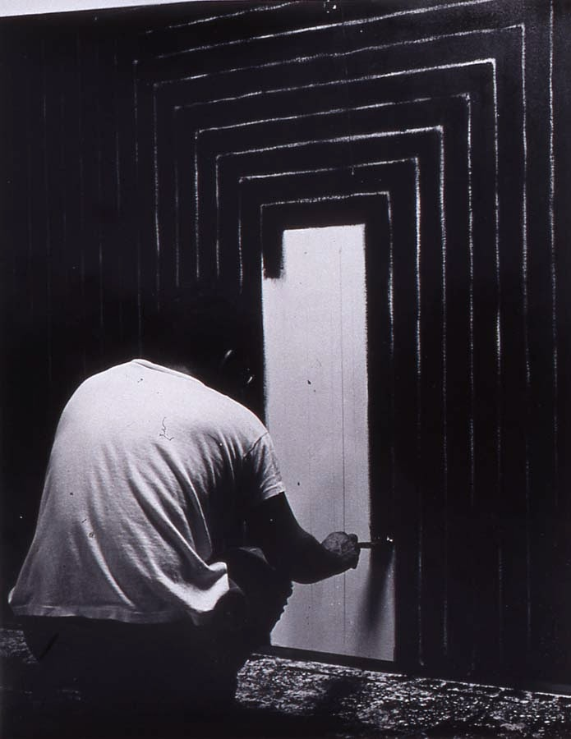
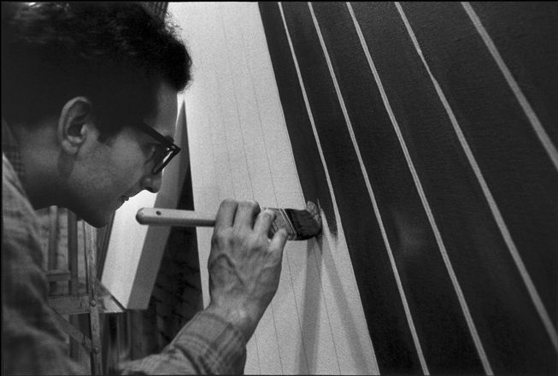
Notes:
Handmade
Large-scale
These are objects
Thick stretcher bars reinforce this
They project off the wall (2-3”?)
Implicates our bodies, as viewers

Slide 4
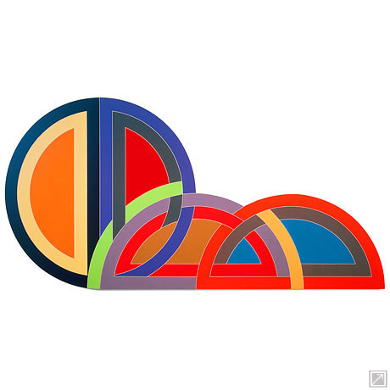
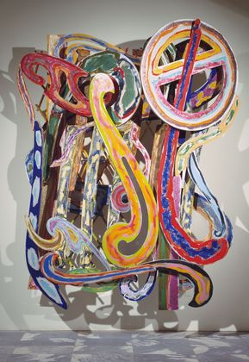
Frank Stella, Ctesiphon I, 1968
Polymer and fluorescent polymer paint on canvas
120 x 240”
Frank Stella, Kastura, 1979
Oil and epoxy on aluminum, and wire mesh, 9' 7" x 7' 8" x 30"
Notes:
Moves on from the Black Paintings
Protractor Series
A group of paintings individually named for ancient circular-plan towns in Asia Minor
Had recently travelled to Iran, citing Persian decorative art and architecture as the series’ inspiration: “The trip was a very big experience for me….There’s all that interlacing, or interweaving….Things doubling back on themselves like snakes swallowing their tails.”
Frank Stella, Ctesiphon I, 1968
A whole circle tumbles into two interconnected halves in the curves breaking and reforming around the interruptions of successive shapes.
The painting’s engaging kineticism reflects Stella’s own creative process—once he had applied tape to control the edges, he painted works without interruption, rarely stopping to redo a color.
Frank Stella, Kastura, 1979
Stella introduces relief into his art
Calls this “maximalist” painting for its sculptural qualities
Opposite of the Black Paintings, which had eliminated all such depth
Using shaped canvases
Exuberant color!
Eventually, his work becomes so 3-D that he is making large, free-standing metal pieces
Painted upon, so painting or sculpture?
Line blurred

Slide 5
“First, I have the experience of happiness and innocence. Then, if I can keep from being distracted, I will have an image to paint.”
Agnes Martin, Leaf, 1965
Acrylic and graphite on canvas, 72 1/16 x 72 1/8
Collection MAMFW
Notes:
AGNES MARTIN (1912-2004)
Often thought of as a minimalist
Considered herself an Ab Ex painter
Lived in Coenties Slip (NY) with other painters of the 1950s – good friends with Kelly
Influenced by Reinhardt and Rothko
Eventually moves to New Mexico
Handmade (abstract and expressive, just not the brash expressivity of Ab Ex male painters)
Rooted in happiness and peace
Rejects notion of artist as “tortured genius”
Notice the grid that undergirds all of her work
Work not about structure, but happiness
About feeling and recognition
Simplified
Allows for experimentation within parameters – frees one up, paradoxically
All works 6 or 5 ft. squares
Martin stated that she came into her artistic maturity around 1960
Her method: a square format; canvas primed with two layers of gesso; hand-drawn pencil lines; thin layers of paint, first in oils, then in acrylic which she preferred because it was much quicker to dry
Student of Eastern philosophy
Paints one piece at a time
Very deliberate
Agnes Martin, Leaf, 1965
Expressing innocence of a tree via grid
Hand-drawn pencil lines
Meditative

Slide 6
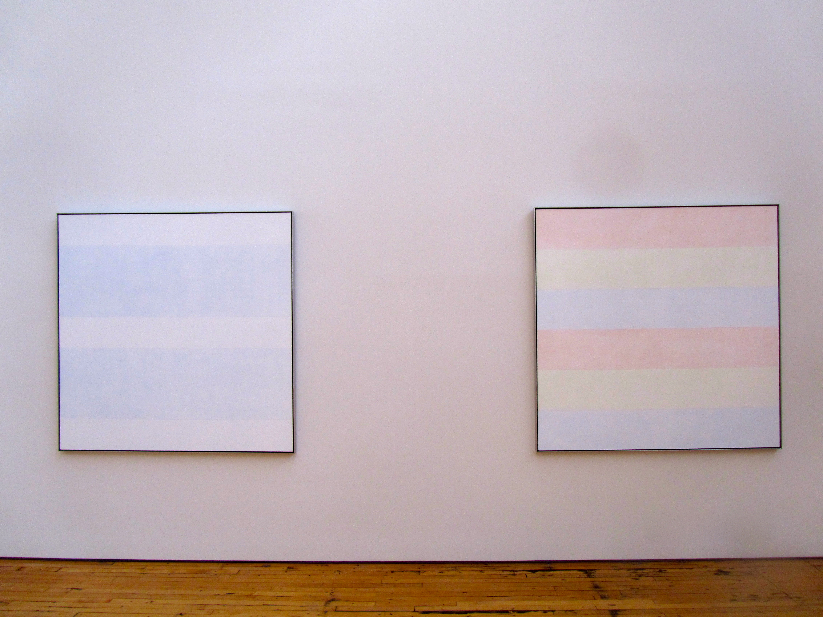
Martin installation at Dia: Beacon

Slide 7
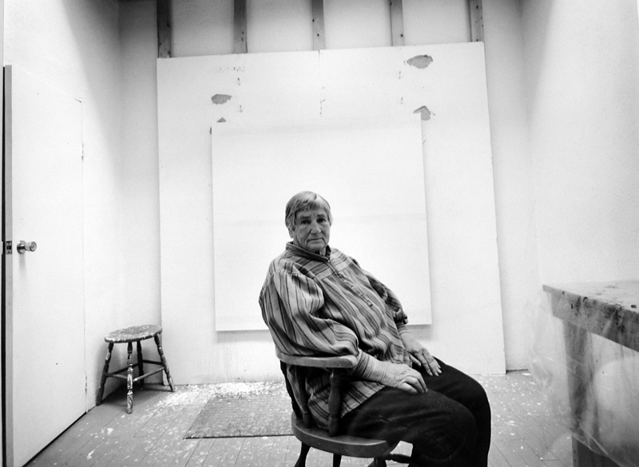
Notes:
Image of Martin in her Taos studio

Slide 8
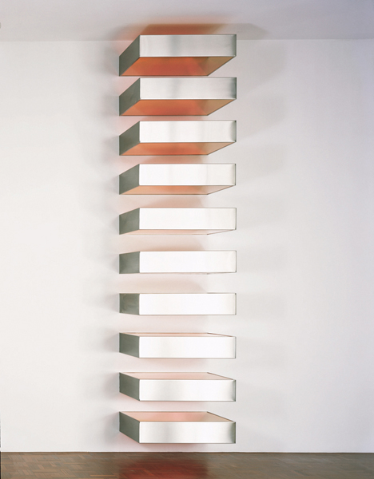
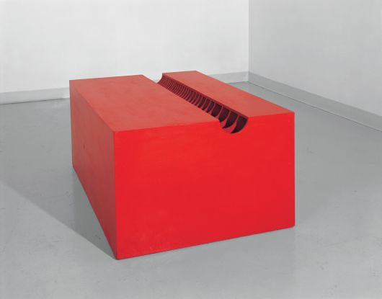
Donald Judd, Untitled (Floor Box with Slotted Trough), 1963
Light cadmium red oil on wood
Donald Judd, Untitled, 1967
Stainless steel and Plexiglas, ten units, each 9 1/8 x 40 x 31 inches Overall 190 1/8 x 40 x 31 inches
Collection MAMFW
Notes:
DONALD JUDD (1928-1994)
American sculptor, painter and writer
Studied philosophy at the Art Students League (1947–8; 1950–53)
Art history at Columbia University (1949–53; 1957–62)
First generation of artists to be college educated!
1959-1965: Writes art criticism for American journals such as Arts Magazine
Champions fellow artists from New York such as Claes Oldenburg, Frank Stella, John Chamberlain and Dan Flavin
86 painting in order to devote himself to sculpture
NOT SCULPTURE – The “Specific Object”
1965: His theories were elaborated in an influential article, ‘Specific Objects’
Of a generation that ignored traditional craft skills in deference to an overriding system or idea
Untitled (Floor Box with Slotted Trough), 1963
Matter-of-factness and simplicity
See inside – no tricks
Directly on the ground – no plinth
Emphasizes their self-sufficiency
1964-1966: Judd perfects a formal vocabulary that was soon labelled Minimalism
Uses different materials
Favorite form was the box, either closed, semi-hollow or transparent
Presented neutrally so as to refute any symbolic connotation
Untitled, 1967, Stainless steel and Plexiglas
Begins to attach boxes to the wall
A stack of alternating solids and voids of equal size
Embodies seriality, either as a simple mathematical progression or as a repetition of a standard unit
Favored metals such as painted steel, aluminum or galvanized iron
These “stacks” use Plexiglas
He did not make these with his hands
He sent exacting specifications to a company close to his studio – The Bernstein Bros.

Slide 9
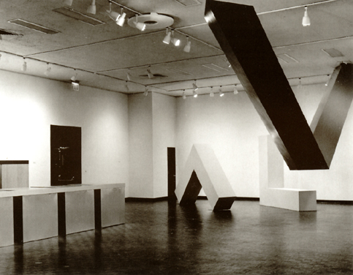
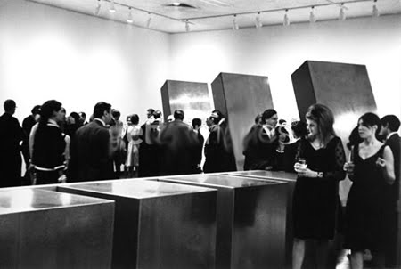
Primary Structures: Younger American and British Sculptors
April 1966
Jewish Museum, New York
Curator: Kynaston McShine
Notes:
1966 - Included in the groundbreaking exhibition ‘Primary Structures' held at the Jewish Museum, NY
Radical – art in relation to space!
No plinths
Direct interaction with 3-D work
Critics called it “ABC Art,” “Minimal Art,” and “reductive art”
All terms rejected by Judd, and others
Remember, his works were “specific objects”

Slide 10
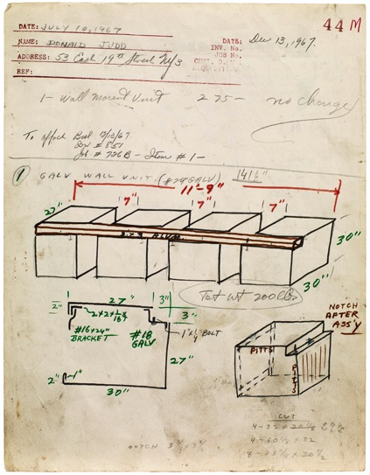
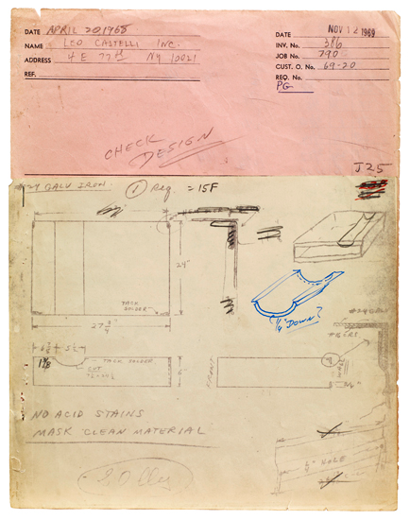
Notes:
Manufacturing work:
They created these boxes, then delivered them
Flawless finish
The artist’s hand is not important – the concept is the artist’s and that is enough
“The point is not whether one makes the work or not... I don't see... why one technique is any more essentially art than another...”

Slide 11
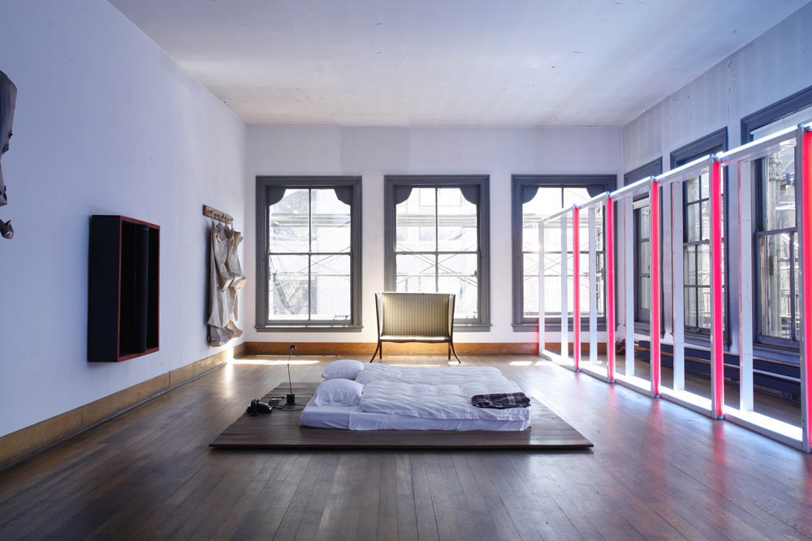
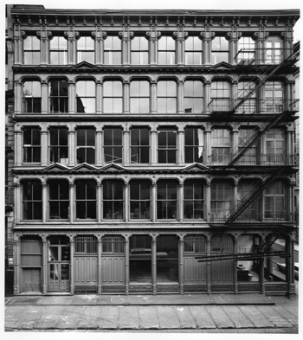
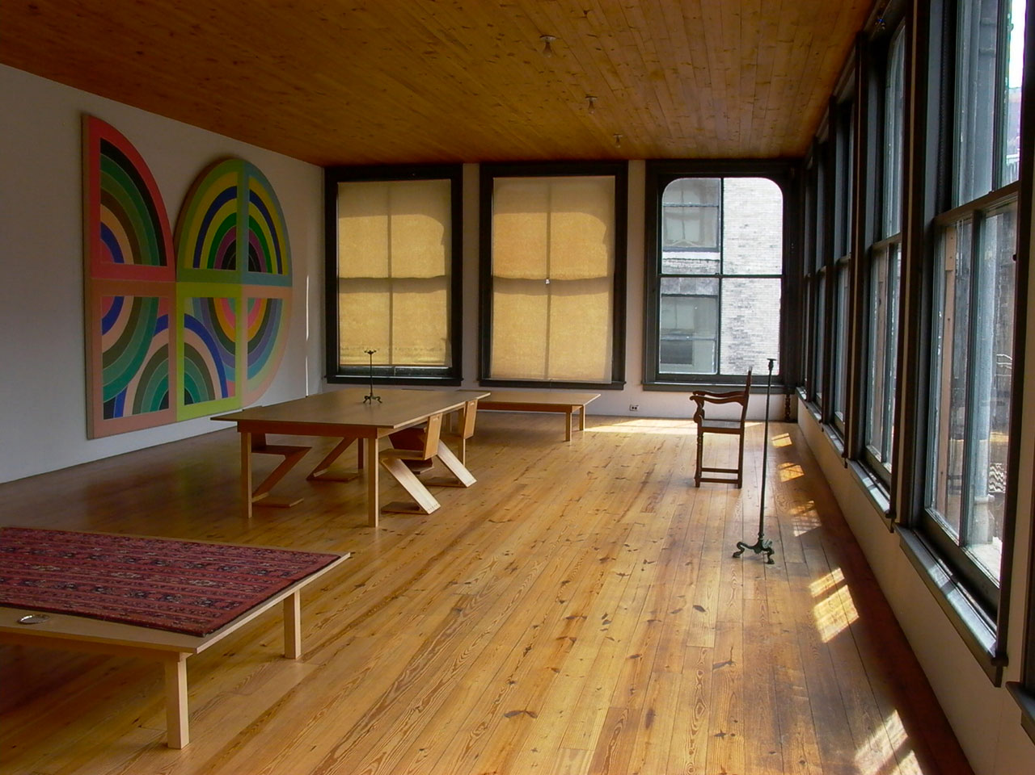
101 Spring Street, NY, NY
Judd Foundation
Notes:
101 Spring Street, NY, NY
Judd Foundation
1968: Purchases 101 Spring Street
Served as his residence and studio for several years…
5-story cast-iron building designed by Nicholas Whyte and constructed in 1870
The only intact, single-use cast-iron building remaining in SoHo
Considered to be the birthplace of "permanent installation," now a hallmark of contemporary art, as well as an inspiration for much of Judd's work
Centered on the belief that the placement of a work of art was as critical to its understanding as the work itself
"I spent a great deal of time placing the art and a great deal designing the renovation in accordance. Everything from the first was intended to be thoroughly considered and to be permanent."

Slide 12
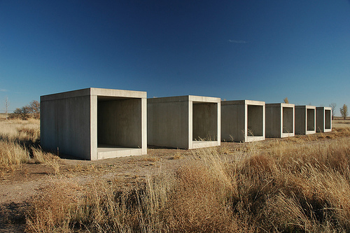
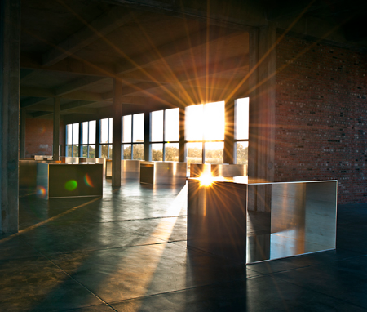
Chinati Foundation, Marfa, TX
Notes:
The Chinati Foundation, Marfa
Judd began in the 1970s to work on a larger scale, gradually creating a type of open-air museum of his work surrounding his studio at Marfa, TX
Preserve and present to the public permanent large-scale installations by a limited number of artists
The emphasis is on works in which art and the surrounding landscape are inextricably linked.
As Judd wrote in the foundation's catalogue:
“It takes a great deal of time and thought to install work carefully. This should not always be thrown away. Most art is fragile and some should be placed and never moved again. Somewhere a portion of contemporary art has to exist as an example of what the art and its context were meant to be. Somewhere, just as the platinum-iridium meter guarantees the tape measure, a strict measure must exist for the art of this time and place.”
On 340 acres of land on the site of former Fort D.A. Russell in Marfa, Texas
1979: Construction and installation at the site began with initial assistance from the Dia Art Foundation
Originally conceived to exhibit the work of Judd, John Chamberlain and Dan Flavin
The collection was expanded and now includes 15 outdoor concrete works by Judd, 100 aluminum works by Judd housed in two converted artillery sheds, 25 sculptures by John Chamberlain, an installation by Dan Flavin occupying six former army barracks, and works by Carl Andre, Ingólfur Arnarsson, Roni Horn, Ilya Kabakov, Richard Long, Claes Oldenburg and Coosje van Bruggen, David Rabinowitch, and John Wesley.
Each artist's work is installed in a separate building on the museum's grounds
Temporary exhibitions feature modern and contemporary art of diverse media

Slide 13
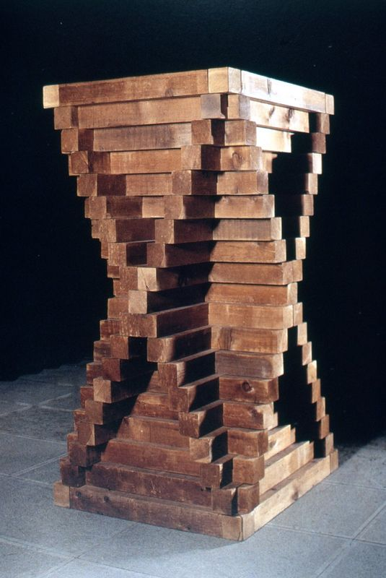
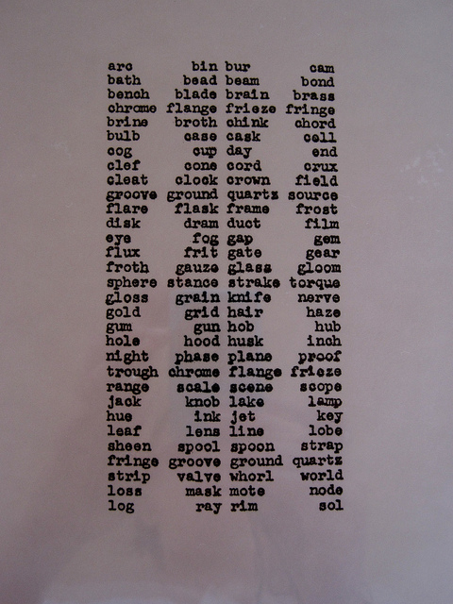
Carl Andre, Cedar Piece, 1959/64
Cedar pine, 173.5 x 92 x 92 cm
Notes:
CARL ANDRE (1935- )
1951-53: Phillips Academy, Andover
1954: Visits England, impressed with Stonehenge
1955-56: Army
1957: Moves back to NY – begins writing poetry
1958: Meets Frank Stella and shares a studio with him
Black Paintings had a considerable influence on André
Their non-referentiality
Their symmetrical and non-hierarchic compositions
Central figure in development of Minimalism
Symmetrical arrangements of units of basic building materials
“Particles” or “Elements”
Carl Andre, Cedar Piece, 1959/64
Early work referencing Brancusi
Also a poet (concrete poetry) – notice the affinity between words and wood
Like Judd, takes sculpture from its traditional base and places it directly on the floor
What does this do?
Makes the viewer move all around it
Allows for a more direct experience
Somewhat anthropomorphized
From your reading, you know that he did not alter his materials
Pre-fabricated, but not for artmaking (like Judd) – for building

Slide 14
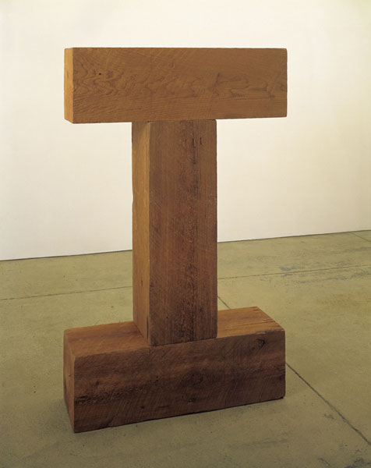
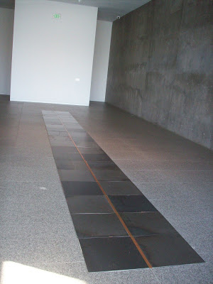
Carl Andre, Tau and Threshold (Element Series), 1971
Western red cedar, 60 x 36 x 12”
Collection MAMFW
Carl Andre, Slit, 1981
Steel and copper
Collection MAMFW
Notes:
Carl Andre, Tau and Threshold (Element Series), 1971
André’s totemic wooden sculptures indebted to Constantin Brancusi
Cut rather than carved
Constructed according to what André called structural building principles
Elements were stacked and interlocked
Weight and mass are key preoccupations
Many permutations possible (in Element Series, this is the case)
Carl Andre, Slit, 1981
Begins using ¾” high, 1 ft. square metal plates
Wood to light for floor works, too easy to move
Homage to Brancusi’s “Endless Column”
Even more basic than Brancusi
“Axial symmetry” – interchangeability of standardized units
Notion of expanded space
All air above the piece is part of the piece
When in the Holzer Gallery, Auping used to say it was the shortest sculpture in the tallest gallery
You may walk on our Andre, but no touching with hands, or kicking of metal
Many museums do not allow walking…always ask
A great thing to do with tour groups – opens up all kinds of talk about art (materials, placement, boundaries, etc.)
Abstract, but recalls roads, rivers, and rail lines
Andre worked as a freight brakeman and conductor on the railway
“The railway completely tore me away from the pretensions of art, even my own, and I was back on the horizontal lines of steel and rust and great masses of coal and material, timber, with all kinds of hides and glue and the burdens and weights of the cars themselves.”
Sense of the blue collar worker comes through
Like Judd, the artist’s hand is not evident – his mind is
Not a conceptual artist
Work is about MATERIALITY
The idea cannot be separated from the object – it must be physically experienced!
Its creation arises out of a desire “to make something to be in the world.”
Its importance lies in the effect it has on its environment and on the viewer’s perception of space.

Slide 15
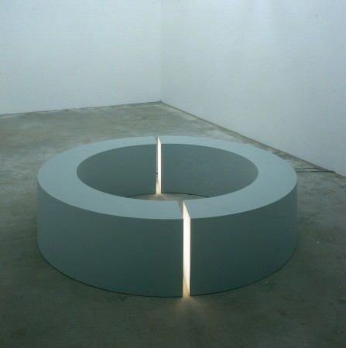
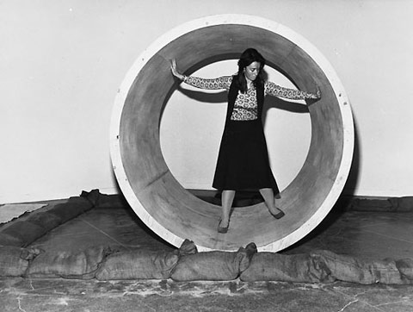
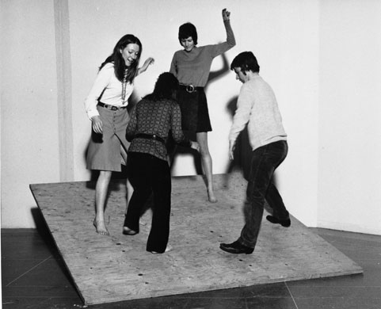
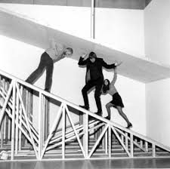
“Simplicity of shape does not necessarily equate with simplicity of experience. Unitary forms do not reduce relationships.”
Robert Morris, Untitled, 1965/71
Fiberglass and florescent light, 24 x 97 x 97”
Collection DMA
Notes:
ROBERT MORRIS (1931- )
1948–50: University of Kansas City and then at the Kansas City Art Institute
Moves around, in Army
1955: San Francisco -- experimental dance and improvisational theatre
1961-1963: Studies art history at Hunter College in New York, where he settled
Writes thesis on Constantin Brancusi (familiar?)
Another artist/writer
Writes for Artforum regularly
1966: “Notes on Sculpture” – sculpture “scale, proportion, shape, mass”
To reveal these properties best, simple forms such as cubes, pyramids, and regular polyhedrons used
These forms “create strong gestalt sensations”
Gestalts -- patterns or configurations where the whole has a significance greater than, and different from, any of the parts considered individually
1950s: Morris grew interested in dance while living in San Francisco with his wife, the dancer and choreographer Simone Forti
NYC: They participate in a loose-knit confederation of dancers known as the Judson Dance Theater
Morris a choreographer for the group
1960s and 1970s: Has a central role in defining three principal artistic movements of the period: Minimalist sculpture, Process Art, and Earthworks
Varied career!
Earliest Minimalist objects as props for his dance performances
Rudimentary wooden construction of these boxlike forms -- function over expression
Used the term “Unitary Objects”
1964-65: Shows entire rooms of these nondescript architectural elements at the Green Gallery
Late-60s: Explores more elaborate industrial processes for his Minimalist sculpture
Aluminum and steel mesh
Many see his work as fundamentally theatrical…
Robert Morris, Untitled, 1965/71
Uses the simple form of a hollow circle
Inserts neon light into it
Creates an odd contrast between the heaviness of the circle itself and the lightness of the neon’s glow
Work based on the idea that a viewer’s physical and perceptual relationship to art is as much a part of a work as any traditional sculptural representation
This work, like others from this period in the 1960s, contains little reference to anything other than the form and materials of the work of art itself
1971: Tate Retrospective – interactive and rowdy – closed down!
2009: Restaged the retrospective, much safer

Slide 16
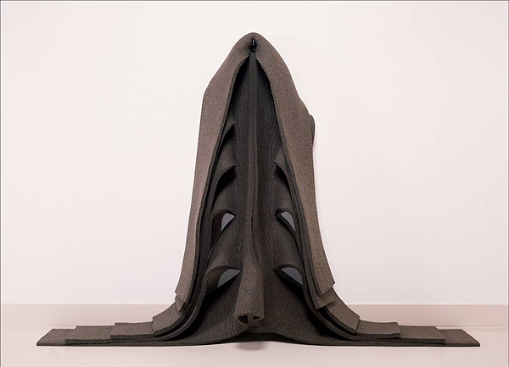
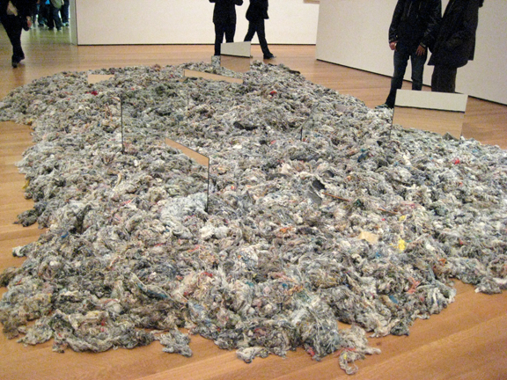
Robert Morris, Untitled, 1970
Industrial felt, 72 x 144 x 18”
Robert Morris, Untitled, 1968
Fabrics and mirrors, dims. variable
Notes:
1960s: Series of Neo-Dada sculptures challenge the myth of artistic self-expression
Ironic “self-portraits” consisting of sculpted brains and electroencephalogram readouts
Late-1960s and 1970s: Uses soft materials for Process Art
Felt works - investigate the effects of gravity and stress on ordinary materials
1968: Shows these works at Leo Castelli Gallery
Subsequent projects: indoor installations of such unorthodox materials as dirt and thread waste, which resisted deliberate shaping into predetermined forms
Also monumental outdoor Earthworks
Artists Tired:
Pop over – looking at real materials in space
Beauty not prized – authenticity of experience is
Critics’ hegemony waning – writing about their own work

Slide 17
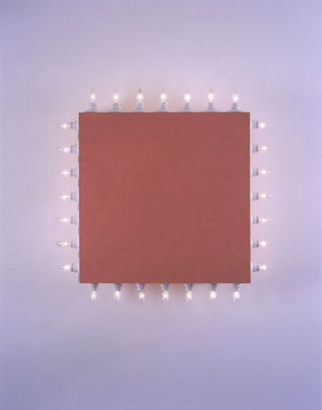
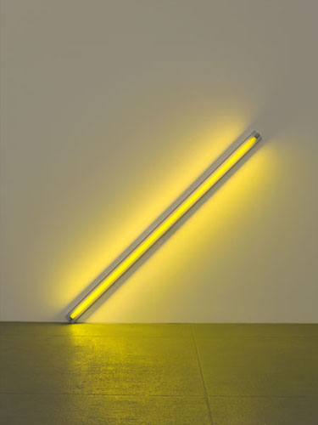
Flavin, 1961 concrete poem
Dan Flavin, Icon V, (Coran’s Broadway Flesh), 1962
Wood, incandescent lights, paint
Dan Flavin, the diagonal of May 25, 1963 (to Constantin Brancusi), 1963
Yellow fluorescent light, 8’ long
Notes:
DAN FLAVIN
Rejected the term “minimalism”
Like Judd and Morris, “sculpture” too confining
Saw his works as too ephemeral, temporary, and architectural to be called sculpture
Used store-bought florescent light bulbs as his medium
1961 poem: first hint of his interest in florescent light
Same year – begins work on icons series
Incandescent and florescent bulbs attached to shallow, boxlike square constructions (wood, Formica, Masonite)
“ICON” evokes the gold-ground religious icons of Byzantine art
Uses term ironically – ambivalence toward his Catholic upbringing
Lacks reverence of a sacred object
Kitschy quality
Cheap bulbs reference bright lights of Broadway
Dan Flavin, the diagonal of May 25, 1963 (to Constantin Brancusi), 1963
Breakthrough florescent piece!
First piece to use florescent light alone
Simplified visual vocbulary
Single bulb against a wall at 45 degree angle
Struck by beauty – “gold” tube his “diagonal of personal ecstasy”
Homage to Brancusi’s “Endless Column”
Bold move!
Light bulb alone is art
Duchampian (an object is art by virtue of selection alone)
But Flavin’s lights are functional
Illuminate the space, thus change the architecture
See that in our two works by Flavin…

Slide 18
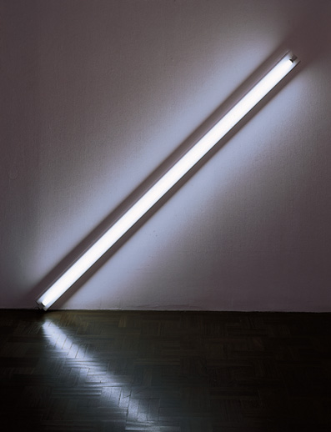
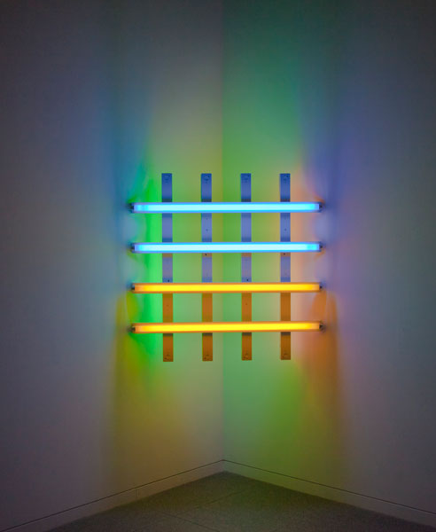
Dan Flavin, Untitled (for you, Leo, in long respect and affection) 4, 1978
Pink, green, blue and yellow fluorescent light, 48 x 48 x 2”
Collection MAMFW
Dan Flavin, Diagonal of May 25, 1963
Warm white fluorescent light, edition 2/3, 96”
Collection MAMFW
Notes:
Dan Flavin, Diagonal of May 25, 1963
Made just after that first Diagonal of May 25, 1963
Made a number of diagonal proposals, with different colors and differently slanting angles
1 – gold light
2 – green, yellow, red
3 – pure white, ultraviolet light (most pure)
“Envisioned the diagonal as a contemporary symbol that "in the possible extent of its dissemination as a common strip of light or a shimmering slice across anybody's wall, had the potential for becoming a modern technological fetish.”
Dan Flavin, Untitled (for you, Leo, in long respect and affection) 4, 1978
Latticework of color
Beacon at the top of the north staircase
Wonderful juxtaposition, when they are both installed
People often “get” the later work – the single white bulb is intimidating to some
How does color affect your feelings?
How does light shape your experience of the space?
That concept of the “icon’ comes out in the ‘78 piece – think of those square, Russian icons of Malevich…

Slide 19
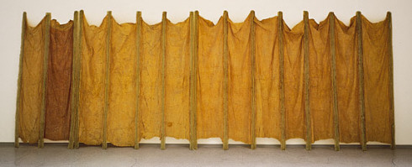
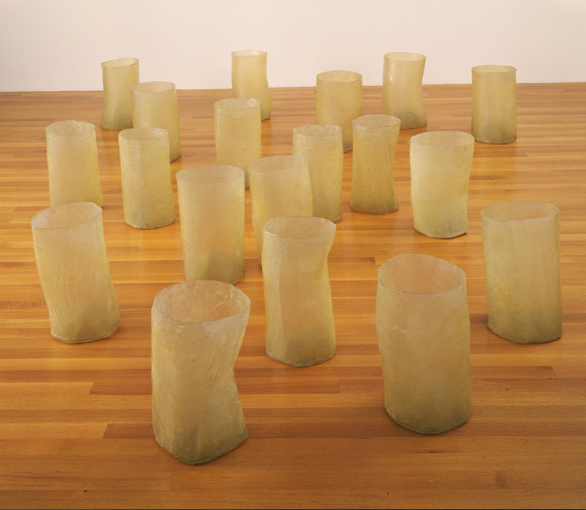
Post-Minimalism
Eva Hesse, Expanded Expansion, 1969
Fiberglass, polyester resin, latex, and cheesecloth, 10’ 2” x 25’
Eva Hesse, Repetition Nineteen III, 1968
Latex and filler over canvas stuffed with polyurethane sheeting, rope, etc.
Notes:
POST-MINIMALISM
Every movement has a counter-movement
Same here
Term coined by art historian and critic Robert Pincus-Whitten
Refers to a general reaction by American artists in late-’60s
Against Minimalism and closed, geometric forms
Eschewed the impersonal object
Not surprisingly, many are women (Minimalism had been a boys’ club)
EVA HESSE (1936-1970)
German-born
Moves to NY
Comes to artistic maturity in the mid-1960s
Women’s movement and sexual revolution are powerful liberating forces
Voices of counterculture gain recognition (some Minimalists were very political, Morris, especially)
Question the tight parameters of Minimalism
Inspired by the human body, random occurrence, improvisation, and the liberating qualities of nontraditional materials
Felt, molten lead, wax, rubber, resins, fiberglass, etc.
Eva Hesse, Expanded Expansion, 1969
Using malleable materials
Abstract and sensual
Uses materials that decompose over time (now, very brittle)
Her goal was to portray the essential absurdity of life
Wedding of contradictions: “order vs. chaos, stringy vs. mass, huge vs. small”
Metaphor for her own female position in the art world
Highlight inherent strength of flexibility and vulnerability
Rigid fiberglass poles support fragile, rubber-covered cheesecloth
Like an accordion, length can change
Possibly a comment of seriality of Minimalism

Slide 20
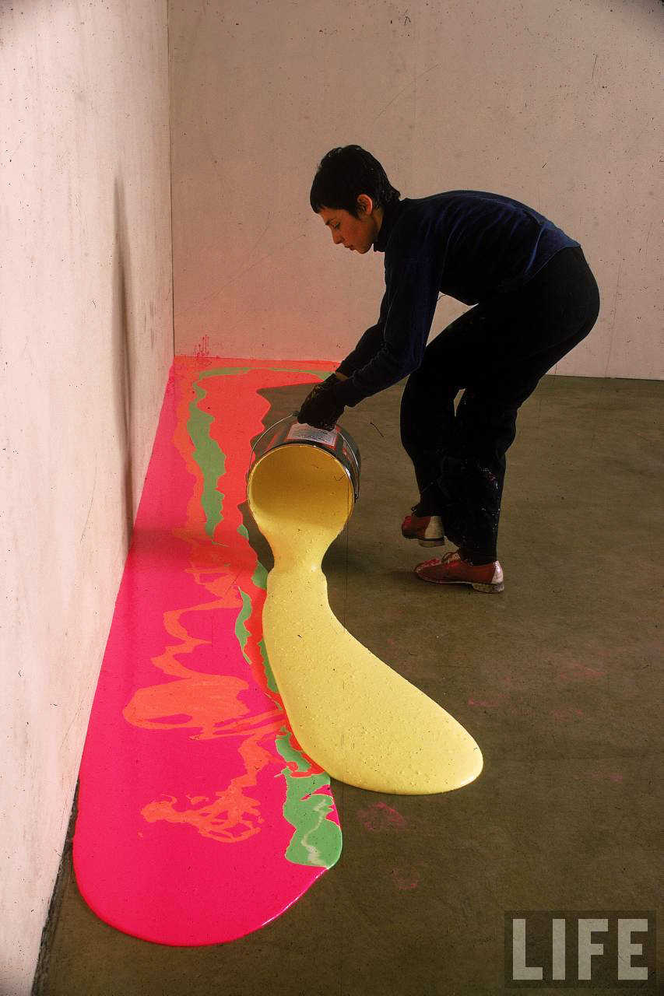
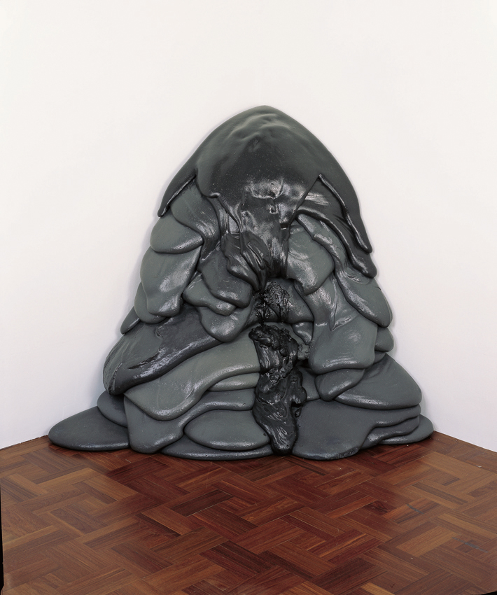
Linda Benglis, For Carl Andre, 1970
Pigmented polyurethane foam
Collection MAMFW
Notes:
LINDA BENGLIS (1941- )
Also a direct response to Minimalism…
“I felt I wanted to define for myself the organic phenomena; what nature itself would suggest to me in sculpture.”
Best-known for her work in polyurethane foam
Pours material directly on the floor, allowing it to do what it does -- PROCESS ART
Final form is a record of its making
Linda Benglis, For Carl Andre, 1970
Oozing, bodily, anti-geometric
Commissioned for our Museum in 1970
Mixes the gestural movements of Ab Ex with the low-art materials of Pop art
Ironic and funny jab at Minimalism via title
Expanding boundaries of art

Slide 21
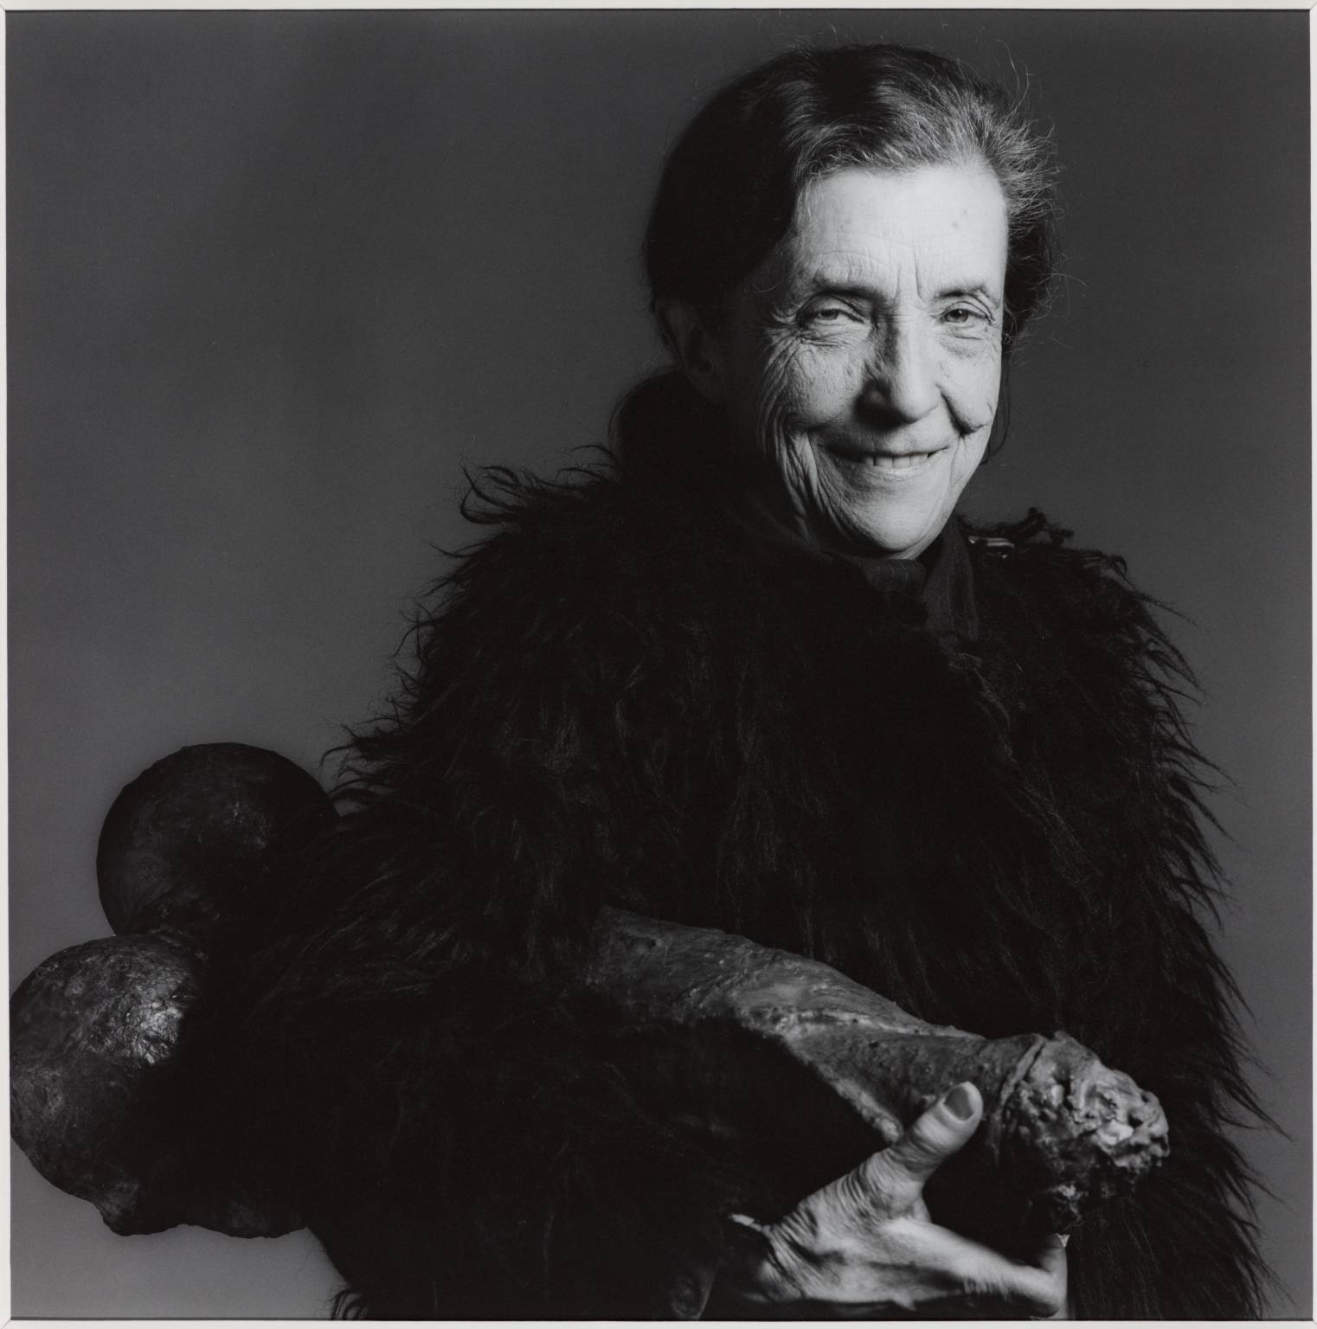
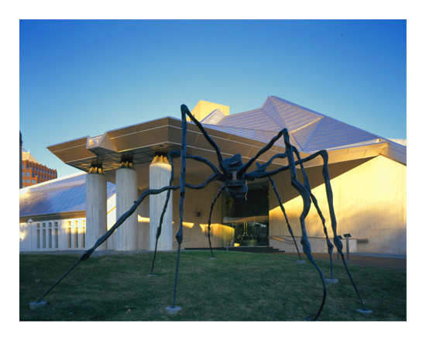
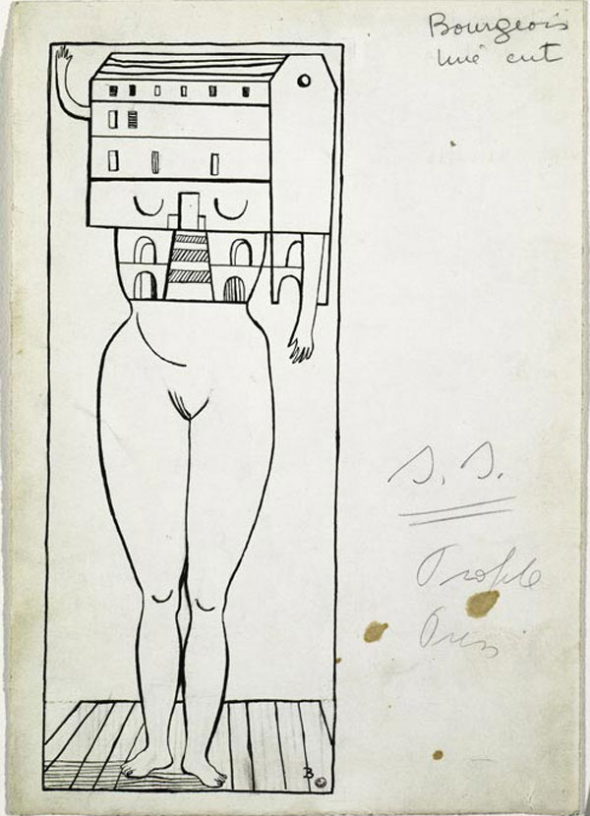
Robert Mapplethorpe, Louise Bourgeois, 1982
Holding “Filette” – phallic-shaped sculpture; title translates to “little girl”
Spider, 1997
Bronze
Femme Maison (Woman House), 1947
Ink on paper
Notes:
LOUISE BOURGEOIS (1911-2010)
Really her own thing
Became well-known much later in her life
French, moved to US with husband
Worked from 1930s to her death in 2010
Work deals with female issues (domesticity, relationships with children and men, protection, menace, sex)

Slide 22
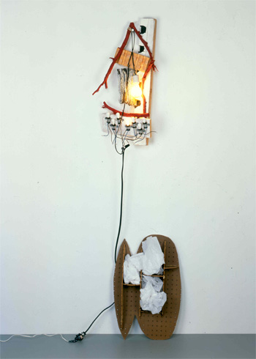
Richard Tuttle, 3rd Rope Piece, 1974
3” length of cotton clothesline and nails
Richard Tuttle, Relative to Our Society, 1990
Collection MAMFW
Notes:
RICHARD TUTTLE (1941- )
Known for his subtle, slight, thoughtful sculptural works
Commonly refers to his works as drawing, not sculpture
Diminutive in scale
Idea-based practice
Quiet work (anti-ab ex)
He was a gallery assistant at Betty Parsons in the early-60s, so would have been very familiar with ab ex painters!
He subverts the conventions of Modernist sculptural practice—defined by grand, heroic gestures; monumental scale
No macho materials here!
Creates small, eccentrically playful objects in humble, even “pathetic” materials
Paper, rope, string, cloth, wire, twigs, cardboard, bubble wrap, nails, Styrofoam, and plywood.
Manipulates the space in which his objects exist
Places them unnaturally high or oddly low on a wall
Prompts viewers to reconsider and renegotiate the white-cube gallery space in relation to their own bodies (like Minimalism in this regard)
Uses directed light and shadow to further define his objects and their space
Influences on his work include calligraphy (he has a strong interest in the intrinsic power of line), poetry, and language
http://www.designboom.com/art/richard-tuttle-winged-sculpture-textiles-turbine-hall-tate-modern-10-15-2014/

Slide 23
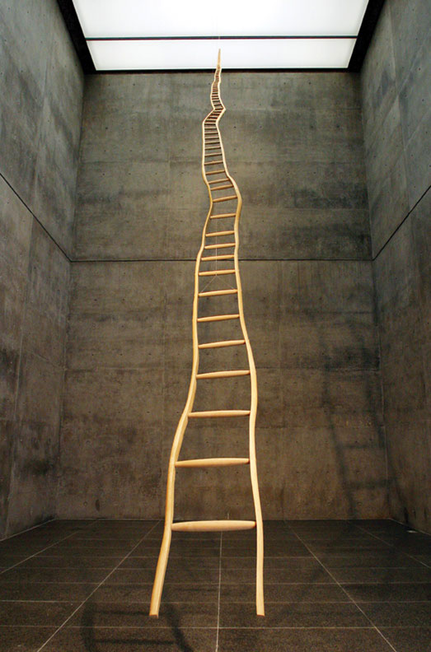
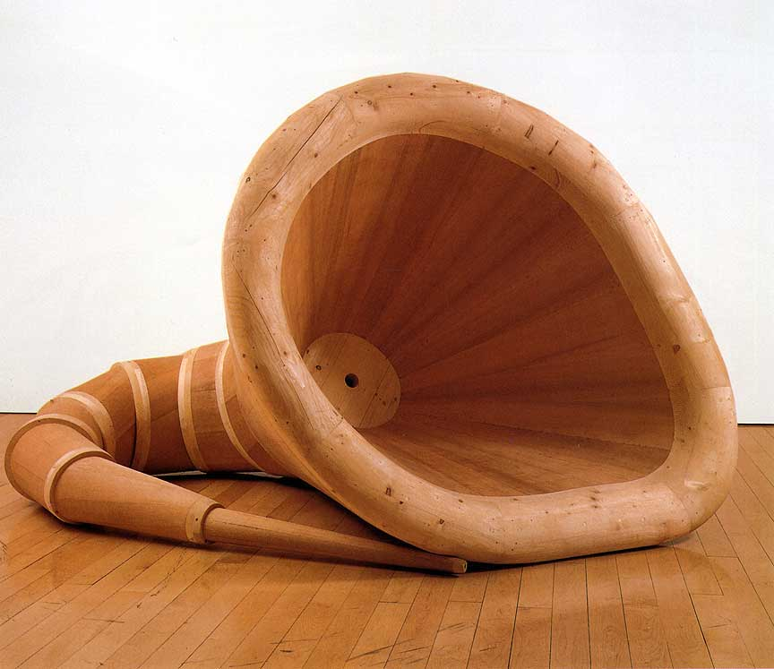
Martin Puryear, Plenty’s Boast, 1994-95
Red cedar and pine, 68 x 83 x 118”
Martin Puryear, Ladder for Booker T. Washington, 1996
Wood (ash and maple), 432 x 22 3/4 (narrowing to 1 1/4 at top) x 3”
Collection MAMFW
Notes:
MARTIN PURYEAR (1941- )
Wood worker / art or craft?
Simple, minimalist forms
Work defies categorization
Serenely quiet and poetic
Explores natural forms and materials, especially a wide variety of woods
Engages issues of history, culture, and identity
Uses concepts of Minimalism, but moves beyond them
Handmade objects
Warm, not cool and detached
A master woodworker who studied carpentry
A number of works relate to African American history, including Ladder for Booker T. Washington.
Martin Puryear, Ladder for Booker T. Washington, 1996
Washington advocated self-advancement through discipline and hard work
He rejected the pursuit of politics and social equality for black Americans in favor of developing vocational and domestic skills
Although he was well-respected within the African American community at large, Washington’s viewpoints were adamantly opposed by some African American intellectuals, who believed that without being politically active, significant equal rights and economic gains were unattainable
The ladder has multiple associations, and Puryear’s homage to Booker T. Washington might include several of these
Ambition, hierarchy, or the impossibility of reaching the top

Slide 24
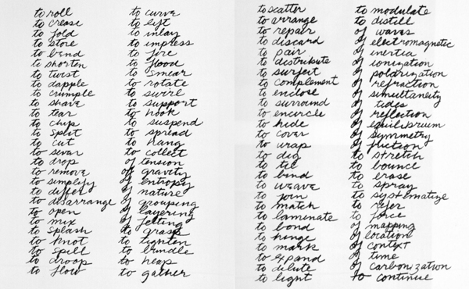
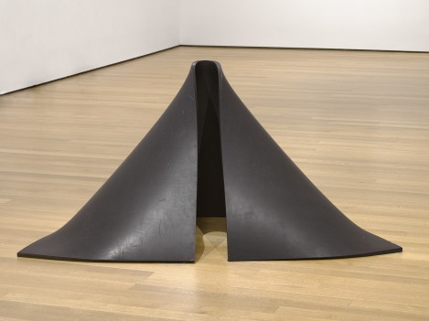
Richard Serra, Verb List, 1967-68
Graphite on paper, two sheets
Collection MoMA
Richard Serra, To Lift, 1967
Vulcanized rubber
Notes:
RICHARD SERRA (1939- )
1963: Works at Yale with Josef Albers on his Interaction of Color
Mid-1960s: Experiments with non-traditional materials -- fiberglass, neon, and rubber
AND the language involved in the physical process of making sculpture
Richard Serra, Verb List, 1967-68
A list of action verbs—”to roll, to crease, to curve”
Enacts these on materials he had collected in his studio
Richard Serra, To Lift, 1967
Uses discarded rubber recovered from a warehouse in lower Manhattan
An enacting of the action verb “to lift”
“It struck me that instead of thinking what a sculpture is going to be and how you’re going to do it compositionally, what if you just enacted those verbs in relation to a material, and didn’t worry about the results?”

Slide 25
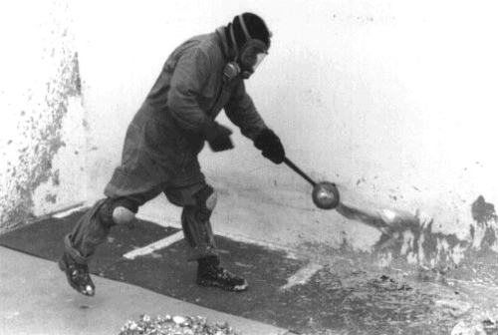
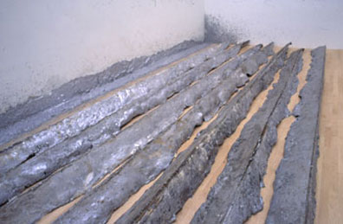
Richard Serra, Gutter Corner Splash: Night Shift, 1969/95
Poured molten lead
Notes:
1968-69: Creates over 100 works that involve the simple manipulation of lead
Comes from the Verb List
Splashings and Castings --- essence of the work lay:
In the act of making
In the specific qualities of the materials
In the spaces in which they are displayed
PROCESS ART!

Slide 26
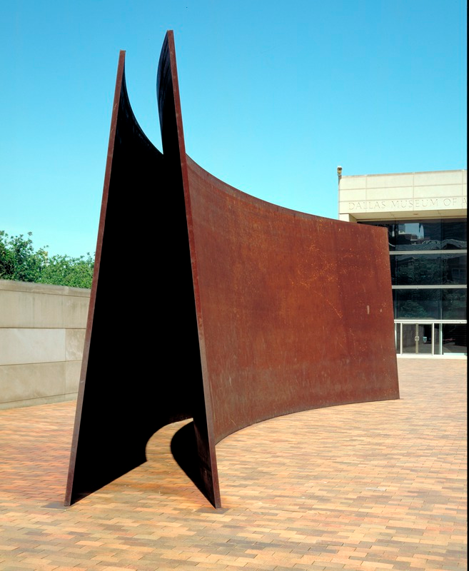
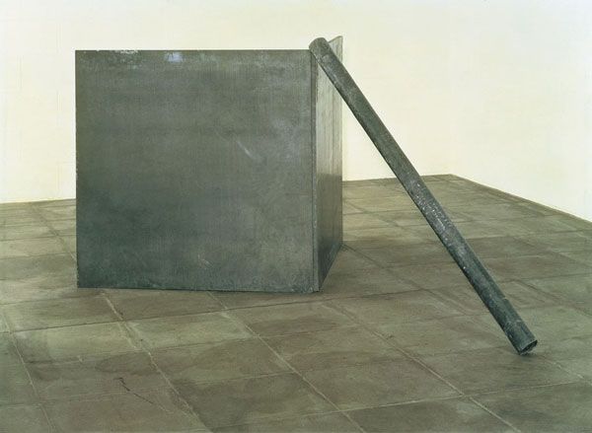
Richard Serra, Right Angle Corner Prop with Pole, 1969
Antimony lead
Collection MAMFW
Richard Serra, My Curves Are Not Mad, 1987
Cor-Ten steel
Collection Nasher Sculpture Center
Notes:
His work may look like Minimalism, but concerned with SPACE and WEIGHT
Like the actions jotted down in Serra’s notebooks, his large-scale works do not simply stand
They plunge, lean or settle
Richard Serra, Right Angle Corner Prop with Pole, 1969
Two lead plates balanced by a leaning lead roll-up
Danger inherent – not welded
About mass and weight – heaviness is palpable
Enacting the verbs!
Richard Serra, My Curves Are Not Mad, 1987
From the early 1980s: works on an increasingly massive scale
Rather than monumentalizing landscapes, he preferred to accentuate the viewer’s perception of the urban spaces
Conceives sculptures for specific sites
Originally for the front of the DMA (see image)
Now in the Nasher Sculpture Center’s garden
Enter the piece
Sense of danger, leaning – very stable, however

Slide 27
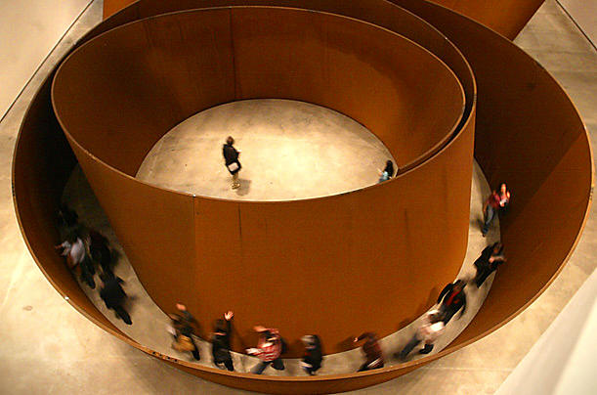
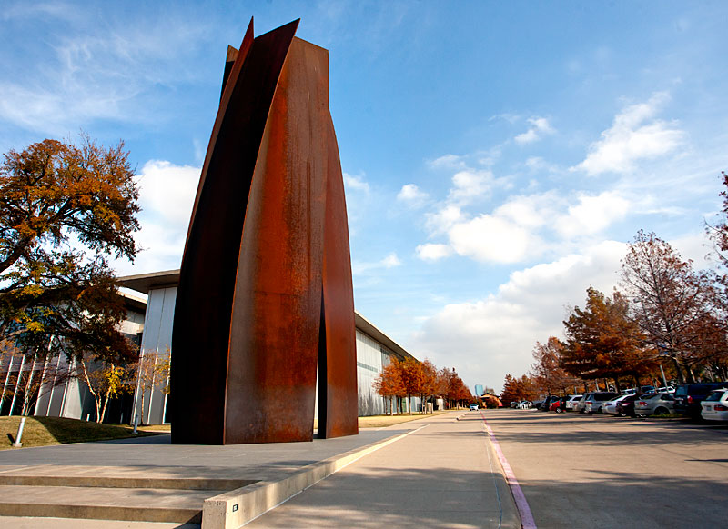
Installation at Dia: Beacon, Beacon, NY
Richard Serra, Vortex, 2002
Cor-Ten steel, 67’ tall
Collection MAMFW
Notes:
The sense that his work becomes an environment to move within is huge now…
How do you navigate the space
Massive – monumental, overpowering

Slide 28
California’s Light & Space Movement
or
L.A. minimalism / The Cool School / Finish Fetish
Craig Kauffman, Untitled, 1968
Vacuum-formed Plexiglas and paint
Collection MAMFW
Notes:
LIGHT & SPACE
SoCal school dedicated to clarity of perception
1960s Los Angeles
Nascent art scene in LA – influenced by surfing and car culture (hot –rod finishes!)
“This is not conceptual work; it is perceptual work.” – James Turrell
Today we will cover the main tenants of the movement
Also discuss the artists involved, many of who are in our collection:
Bruce Nauman
Ed Ruscha
Robert Irwin
Larry Bell
Craig Kauffman
And we will look at contemporary artists deeply indebted to this perceptual revolution in the visual arts…
LIGHT is their primary interest
Directing the natural flow of light
Embedding artificial light within objects or architecture
Playing with light through the use of transparent, translucent, or reflective materials
Again, these artists influenced by California car culture (shiny, perfect finishes) and the aerospace industry (use of resins and various other plastics)

Slide 29
Notes:
1971 - UCLA University Art Gallery titled Transparency, Reflection, Light, Space
Introduces the movement…
Exhibition included work by Alexander, Bell, Irwin, and Kauffman
As we have seen….
1960s - Minimalism gained momentum in NY
SoCal artists began to adopt qualities of minimalism
They added a uniquely Californian spin
Ephemeral — the work no longer becomes about the object itself, but rather about perception.
Works are activated by the viewer’s perceptual gaze.
These works were also very conscious of their surroundings - often constructed for a site-specific installation.
KEY ATTRIBUTES of this work:
Immaterial, but not always
When materials are used, they highlight the elusive and transitory

Slide 30
Notes:
Minimalism vs. Light & Space
Sometimes referred to as “West Coast minimalism”
Also known as “L.A. minimalism,” “The Cool School,” and “Finish Fetish”
This is not quite accurate
Same time period
But…minimalism concerned with physicality of the piece – MATERIALITY!!
Similarities with minimalism:
Same time period
Unelaborated geometric forms
Non-referential (literalness)
Factory fabrication
Emphasis on a direct experience with the piece
Differences from minimalism:
Dematerialized the physicality of minimalism
Emphasizes perception over the objecthood of the object
Work seen from ALL sides, not just the three sides of minimalism (or any 3-dimentional work to that point)
Light and Space works are very sensitive to their environment.
They reflect and define space, rather than displace it.

Slide 31
FERUS GALLERY 1957-1966
"I remember the word 'Ferus' outside had this kind of magic to it. Ferus had a much sparer approach to showing art. If you want to put a tiny painting on a single big wall, you're welcome to it. And the artist is the boss."
—Ed Ruscha, Ferus Gallery artist
Notes:
Ferus Gallery (1957-1966)
1957: Founded by artist Edward Kienholz and curator Walter Hopps
Small storefront space
In the 60s --- “plastics geek” club of mostly men, with a few very notable exceptions
Helen Pashgian and Mary Corse
Nurtured Los Angeles’s first significant post-war artists
Hosted debut exhibitions for Ruscha, Ed Kienholz, Ed Ruscha, Craig Kauffman, Wallace Berman, Ed Moses and Robert Irwin, among many others

Slide 32
“ ‘Culture’ meant ‘art’ and ‘art’ implied ‘new,’ and ‘new,’ as everybody was informed, meant California — particularly Los Angeles.” – Peter Plagens, critic
Irving Blum with Andy Warhol's Campbell's Soup Cans Ferus Gallery
Los Angeles, 1962
Ed Moses, John Altoon, Billy Al Bengston
and Irving Blum, 1959
Notes:
Also played a role in solidifying the careers of many NY artists: Lichtenstein, Warhol, Judd, Stella, Rauschenberg and Johns
Under the directorship of Irving Blum (1958-1967)
In 1962, Andy Warhol: Campbell's Soup Cans was Warhol’s first solo exhibition and the first exhibition of the soup cans. Five of the canvases sold for $100 each, but Blum bought them back to keep the set intact.
Showed assemblage art, abstract expressionism, Light and Space, and Pop art
Finish Fetish—a style that emphasized gleaming surfaces—and Light and Space—art about perception—were Ferus-bred styles that allowed L.A. to distinguish itself from the rest of the art world.
Background…history of LA art scene
LA a growing metropolis
Can afford to support a growing art scene
1950s:
Only a handful of galleries
Not a huge market for contemporary art
1960s:
By 1964, at least 70 legitimate galleries in LA
Art world grew, more informal spaces emerge
NY art is making its way to LA
Galleries are able to thrive!
Ferus brought a certain cache to the work being made in LA
Blum brought a lot of class to the gallery – wealthy collectors were comfortable going there, along with avant-garde artists
“The Cool School” is born

Slide 33
Veterans of the Ferus Gallery. From left: Robert Irwin, Ed Moses, Craig Kauffman, Ken Price, Billy Al Bengston, Larry Bell
Ferus Gallery Artists, 1959
From Left: John Altoon, Craig Kauffman, Allen Lynch,
Ed Kienholz, Ed Moses, Robert Irwin, Billy Al Bengston
Notes:
Good-natured humor there from the start
A history of trouble with the LAPD vice squad for exhibiting controversially suggestive and erotic artwork
California much lighter than the seriousness of minimalism in NY
A great sense of experimentation - what do they have to lose?

Slide 34
Notes:
BRUCE NAUMAN
A great experimenter….
Confronted with “What to do?” in his studio soon after graduating
“If I was an artist and I was in the studio, then whatever I was doing in the studio must be art. At this point art became more of an activity and less of a product.”
A sense of FREEDOM!
What is art? What is the role of the artist
1966-1970: made several videos
Uses his body to explore the potentials of art and the role of the artist, and to investigate psychological states and behavioral codes.
Also has an interest in language, often manifesting itself in a playful, mischievous manner.
Let’s look briefly at his work using lighted environments
Psychologically testing

Slide 35
Bruce Nauman, Performance Corridor, 1969
Whitney Museum of American Art
Notes:
1967-1968: Performs various repetitive, tasklike exercises in his studio
Bouncing against a corner of the room
Slowly walking around the perimeter of a delineated square
Films these actions
Early 1970s: Withdraws his presence
Corridors
Manipulates the movement and experience of the beholder
Performance Corridor, 1969
Transitional piece
Originated as a prop for a solitary, videotaped performance, Walk with Contrapposto (1968)
Nauman is seen walking up and down a narrow passageway, shifting his hips back and forth with each step in an exaggerated imitation of the conventional pose of classical sculpture.
The corridor itself was a makeshift structure: two parallel wallboards form a 20-inch-wide passage that is blocked at one end
The narrow space could just contain the movement of the artist's body
For the Whitney’s seminal 1969 show, Anti-Illusion: Procedures/Materials, Nauman transferred this prop to a public exhibition space
Allows the viewer to decide whether or not to enter the structure and how to move through it
Uncertainty and frustration
Nauman recalled feeling some frustration at not being able to more fully "control the situation.“
In subsequent corridors, he developed a number of devices to accomplish just this, from mirrors and intense, colored fluorescent light…

Slide 36
Bruce Nauman, Green Light Corridor, 1970
Notes:
Late-60s: Claustrophobic and enclosed corridors and rooms that could be entered by visitors
Evoked the experience of being locked in and of being abandoned
Manipulation of light is paramount

Slide 37
Notes:
Viewer experience and perception is key to this work
Nauman has two videos in our collection
His work is not media-specific (performance, video, neon, sculpture, etc)
His various works are more conceptually connected than anything

Slide 38
“I make spaces that apprehend light for our perception, and in some ways gather it, or seem to hold it…my work is more about your seeing than it is about my seeing, although it is a product of my seeing.”
Notes:
JAMES TURRELL
Work offers profound revelations about perception and the materiality of light
Uses a refined formal language to create quiet, almost reverential atmospheres
His installations celebrate the optical and emotional effects of luminosity
Turrell’s artworks undermine expectations and assumptions about objective reality
What is light – is it a mass, or a hole?

Slide 39
James Turrell, Stufe Pink, 1968
Projection Piece
Notes:
Building on his early research into sensory deprivation
Encourages a state of reflexive vision that he calls “seeing yourself seeing.”
We become aware of the function of our own senses and of light as a tangible substance.
Projection Series
A Turrell Projection is created by projecting a single, controlled beam of light from the opposing corner of the room.
The projected light appears as a three dimensional form
Very convincing, a woman once leaned against the light, believing it to be a wall, and fell, breaking her wrist!

Slide 40
“Ganzfeld”: a German word to describe the phenomenon of the total loss of depth perception as in the experience of a white-out. Turrell artificially creates a similar experience through the controlled use of light, coved corners and an inclined floor.
Akhob, 2013
Notes:
1967: Ganzfeld Series
“Ganzfeld”: a German word to describe the phenomenon of the total loss of depth perception as in the experience of a white-out.
Turrell artificially creates a similar experience through the controlled use of light, coved corners and an inclined floor.
Uses light to create retinal effects in the viewer
Almost all of Turrell’s works ask us to see color and light as a medium
Like a deer caught in headlights
We stare in disoriented confusion and begin to ask new questions

Slide 42
Sky Pesher, 2005
Walker Art Center Minneapolis, Minnesota, USA Latitude: 44.968578 Longitude: -93.288422
Notes:
Skyspaces
A Turrell Skyspace is a specifically proportioned chamber with an aperture in the ceiling open to the sky.
Skyspaces can be autonomous structures or integrated into existing architecture.
The aperture can be round, ovular or square.
Makes one aware of the sky in a very unique way.
The sky almost becomes an object.

Slide 43
Doug Wheeler, DW 68 VEN MCASD 11, 1968-2011, San Diego
An “infinity environment”
Notes:
Doug Wheeler
Long fascinated by the illusory quality of landscape as glimpsed from the vantage point of an airplane.
SPACE
Lifelong pilot
Ever-receding horizon
We fly in a curve, yet it feels like a straight line
By mimicking the sensation of the earth’s rotational pull and curvature, Wheeler alters the traditionally static viewing experience of a work of art
Destabilizes our innate sense of equilibrium
Imparts the feeling of moving with the earth towards an unreachable horizon
Specializes in installations -- “Infinity Environments”
Like Turrell, invokes light as an almost tactile presence

Slide 44
Doug Wheeler, Untitled, 1969, acrylic on canvas with neon tubing
Collection Museum of Contemporary Art San Diego
Notes:
Emphasizes the viewer’s physical experience of space
Focuses attention on the way light almost imperceptibly changes along the horizon as the earth turns
Destabilization!
The story goes…he invited a few NY dealers to his Venice, CA studio to show them a new piece that used phosphorous paint and lights to create the sensation of a mistlike piece bisecting the studio.
They, instead, made a beeline to some earlier, popular light works that acted more like paintings, hung on the wall. (like this one)
Never worked with them – they didn’t get it
He actually has refused many a museum exhibition because he is concerned his work won’t be shown the way he intends.
Therefore, his work has been seen mostly on the West Coast and in Europe

Slide 45
Dan Flavin, Icon I, 1961
Notes:
Flavin’s Icons
Similar to Flavin’s work
But Flavin is showing where light and color emanate from

Slide 46
Doug Wheeler, RM 669, 1969 Vacuum-formed Plexiglas and white UV neon light 96 x 96”
Notes:
Curved white walls encased by a floor and ceiling that seem to recede with every step one takes toward the square of light positioned on the far wall.
Inside there are no hard edges
The sides of the room waver, while the bodies of other viewers sharpen to silhouettes.
To achieve these illusory effects, Wheeler employed several manipulations, including minimizing the number of visible elements within the space and using white paint on the interior surfaces to enhance the way light “paints” the room.
He also defused the light so that it casts no shadow.
The result is a phenomenon that overtakes the artwork’s individual components
A hallmark of Light and Space work --- lacking form, the materials dwindle in significance compared to the viewer’s experience.

Slide 47
“Seeing is the
subject of art.”
Notes:
Robert Irwin
“site-conditioned” projects take their cues from, and are dependent on, their surroundings
Results in unexpected visual and aesthetic outcomes
The work is characterized by its rootedness in the relationship between a work’s physical manifestation and the viewer’s perception
Late-60s: Made a series of “discs”
This work ultimately compelled him to abandon the production of discrete objects in favor of the creation of environments
Interested in the fundamental nature of experience

Slide 48
Robert Irwin, Untitled, 1968
Plastic and lighting, 53 5/8 inches diameter
Collection MAMFW
Notes:
1966: His concerns led him to the convex disc format
He adopted the circular shape because the traditionally rectilinear format of painting no longer made sense to him
A convex disc that projects twenty-four inches from the wall
Plastic tube supports this
Multiple coats of a white hue have been spray-painted onto the disc’s surface (hot rod culture!)
As the opaque paint moves toward the edges, it thins to transparency
A three-inch band divides the circle in half, and four floodlights bathe the object in light
The disc, wall, light, and shadows merge to offer a shifting sense of palpability and indeterminacy, and a play between the real and the illusionistic
A work that appears to dissolve into its environment, in his words, to "more or less transcending painting."
A site/sight for experiencing the beauty, wonder, and complexity of visual perception.

Slide 49
Robert Irwin, No Title, 1966–67
Synthetic polymer on aluminum with four flood lights, 48 in. (121.9 cm) diameter; 13 in. (33 cm) depth

Slide 50
Robert Irwin, Niagara, 2012
Albright-Know Gallery, Buffalo
Notes:
Most interesting when once walks along the piece, not standing directly in front of it
Almost develop a sense of a musical score
Complicated rhythms develop

Slide 51
“My media isn’t the glass, it’s the light that hits the glass.”
Larry Bell, Untitled (from the Terminal Series), 1968
Collection MAMFW
Notes:
LARRY BELL
Untitled (from the Terminal Series), 1968
“a distraction-free work that can induce a contemplative, even spiritual, attitude.” – M. Thistlethwaite
The Terminal Series
All works should be 50 inches high, no matter the size of the individual cube
Pedestal
38” high Plexiglas support is translucent, highlighting the smoky-gray color of the glass box.
Can see into and through all sides
An indicator that this is art
Coloration
Made by tinting clear class with a High Vacuum Optical Coating Machine
“Front surface” technology – applied a reflective film to the front of the glass
Later, used a large machine to do this
originally manufactured for the United States Air Force to coat the glass surfaces of fighter plane cockpits
allowed the artist to chemically bind four extraordinarily thin layers of atomized mineral/metal compounds to the glass
Too heavy a tint would render the interior of the cube invisible; an absence of coloristic variance would cause the viewer's perceptual experience to be a tad one-dimensional.
Each pane of colored glass is slightly more heavily tinted at its edges, growing less opaque toward its center.
Give a sense of mystery
Movement
The work always prompts the viewer to move about it, thus changing their viewpoint and augmenting their perception

Slide 52
Notes:
Bell in his studio, Taos, NM
Not ordered, like Minimalists, but handmade

Slide 53
Larry Bell, Flaw, 1968
From the Terminal Series
Notes:
Another example
Iridescent here, the color more noticeable

Slide 54
Larry Bell, Iceberg and its Shadow, 1974-75
Notes:
Provides the viewer with many viewpoints
Changes in scale
Opportunities to see differently
Translucent, reflective, and opaque
Changes according to the space it occupies
This work (the artist's largest) was on display at the Modern in 1977 (in our days as the Fort Worth Art Museum).
This ambitious work, comprised of fifty-six mirrored panels arranged in two parallel sections, was never installed in its entirety.
Instead, segments of it were installed in various iterations and according to the time and space constraints of its host institutions.
Iceberg and Its Shadow was most completely installed during its time at the Modern (time constraints prohibited the full installation of the piece).

Slide 55
Peter Alexander, Orange Wedge, 1970
cast resin
Notes:
PETER ALEXANDER
Well-known for his sleek resin sculptures
Poured molten resin in carved wood molds
Handmade!
Geometric works in resin are simple and understated
Clearly show his ability to evoke feeling with little detail
Also works in paint, pastel, and other mediums
Began surfing when he was 13 – preparing the surfboard had a big effect on him
Began casting small boxes out of resin
Small rooms, places to go
Surface must be pristine so you could “enter” it, like the ocean!
Wedges
From an airplane, he saw how ocean color changed as it met the sand
Wanted to make this visual effect in sculpture
It becomes part of the environment it is in
Therefore, YOU can become part of BOTH
Resin looks like water – smells quite different!

Slide 56
Peter Alexander, Untitled (Drip), 1969
Polyester Resin
Notes:
Never touched it, used buckets and jars to pour
Becomes brittle with age
Breakage inevitable
When a surface is even slightly scratched, it affects perception
Conservation very important!
Color is fugitive

Slide 57
Eva Hesse
Contingent 1969
Cheesecloth, latex, fiberglass
installation (variable) 350.0 (h) x 630.0 (w) x 109.0 (d) cm
Richard Serra
Splashing, 1968
Notes:
Reminded me of two post-minimalist artists, Serra and Hesse
Flaccid, organic materials used
Process evident in the final form
Truth to materials and Ephemerality are key
Like the L&S artists, they effectively removed the boundaries between painting, sculpture, and architecture!

Slide 58
Peter Alexander, Cloud Box, 1966
Cast Polyester Resin, 10 x 10
Notes:
Stopped working with resin (polyester) in 1972
Too nasty!
Picked it up again in 2005 (urethane)
A piece at the Pompidou was broken, so they asked him to make a new piece
Interested in the light of Vermeer
A light so still, like being underwater
Achieved this effect by injecting pigments into the resin at various stages of the hardening process
COLOR
How do we feel when looking at a specific color?
How do colors influence us?

Slide 59
Craig Kauffman, Untitled, 1968
Vacuum-formed Plexiglas and paint
Collection MAMFW
Notes:
CRAIG KAUFFMAN
Perhaps the first LA artist to use PLASTICS
Created wall reliefs
Among the first of his generation in California to become aware of the new American painting out of NY
Also very connected to European post-war developments…

Slide 60
Yves Klein, Monochrome bleu sans titre (IKB 45), 1960
27 x 46 cm.
Notes:
MONOCHROME ABSTRACTION
In Klein’s case, color and abstraction paramount
Linked them to “an open window to freedom”
RECALL…Klein adopted this hue as a means of evoking the immateriality and boundlessness of his own particular utopian vision of the world.

Slide 61
Notes:
Klein actually had an exhibition at Dwan Gallery in 1961
L&S artists would have seen it

Slide 62
Red-Blue, 1964
Synthetic polymer paint on vacuum-form Plexiglas
7' 5 5/8" x 45 1/2" x 5 1/8" (227.4 x 115.4 x 13 cm)
Collection MoMA
Notes:
1960s: Began painting on glass
Too fragile
Moved to acrylic plastic as a support (1964-70)
Further inspired by ever expanding plastic merchandise packaging
Sought out craftsmen at commercial factories to learn the technique
Created a series of 3D wall hangings
Some inspired by the large plastic fruit clusters on the wall of an LA donut shop he frequented!

Slide 63
Left: Craig Kauffman, Chartreuse-Red, 1965; Right John McCracken, Black Plank, 1974
Notes:
Very much objects!

Slide 64
Untitled, 1968
Molded Plexiglas, painted
43" x 7' 5 1/8" x 16 1/4" (109.1 x 226.2 x 41.2 cm)
Collection MoMA
Notes:
Classic Kauffman lozenge-shaped “bubble”
Vacuum-formed Plexi, painted from the inside
Exterior is smooth and reflective, pristine
PROCESS
A relatively thin sheet of plastic is heated in an oven until softening temperature reached
Pulled into a mold with a vacuum
Kauffman prepared his own convex molds using Formica-coated plywood
Used a spray mask – a thick rubber material – to mask out the differently colored areas before spraying them
A delicate process – often cracked under stress from solvent and he had to start start over from scratch.
Next class, Conceptual Art, Arte Povera, and Earth Art – we see artists continue to stretch the parameters of what art can be…

